Slide 1
Impact of Ukraine full trade liberalization on EU producers/manufacturers
AVEC – Association of Poultry Processors and Poultry Trade in the EU countries
CEFS – European Association of Sugar Manufacturers
CEPM – European Confederation of Maize Production
CIBE – International Confederation of European Beet Growers
Copa-Cogeca - the united voice of farmers and their cooperatives in the European Union
EUWEP – European Union of Wholesale with Eggs, Egg Products, Poultry and Game

Slide 2
Agenda
Situation before and after the war
Presentation of the impact of the trade liberalization for EU producers and manufacturers
Potential political impact of the trade liberalization
Commission’s proposal for the renewal of Ukraine ATM
Amendments to the proposal required to ensure survival of EU farmers and manufacturers

Slide 3
1. Situation before and during the war
Before the war, Association Agreement with TRQs + Black Sea corridor was open
Start of the war => transport through the Black Sea problematic
6th June 2022: introduction of the 1st Ukraine ATM: full liberalization renewed in June 2023

Slide 4
1. Situation before and during the war
Commodity | TRQs | Imports in 2021 | Imports in 2022 | Imports in 2023
Cereals | 2 018 800 t | 7 888 05 t | 15 996 05 t | 18 000 000 t
Oilseeds (oilseeds, oilseeds meal, oilseed oil) | Tariffs on several oilseeds’ products | 5 381 226t | 8 528 088 t | 7 800 000 t
Poultry meat | 70 000 t (net weight) +20 000 t (net weight - not cut, frozen) | 102,892 t (cwe) | 162 811 t (cwe) | Est. 230 125 t (cwe)
Eggs and albumin | 3 000 t (expressed in shell eggs equivalent) +3 000 t (expressed in net weight | 5 590t | 23 622 t | 43 366 t
Sugar | 20 070t | 17 495 t | 15 2778t | Est. 441407 t
Consequences of the full liberalization

Slide 5
2. Presentation of the impact of the trade liberalization for EU producers and manufacturers
Cereals and oilseeds:
Trade has slowed down for EU cereals and oilseeds, in some region farmers do not manage to sell regardless of the price
Prices have decreased, drastically in some MS
Markets have been lost
Issues for storage and transport

Slide 6
2. Presentation of the impact of the trade liberalization for EU producers and manufacturers
Cereals and oilseeds:
Hungary:
Flows and prices: The sales have completely stopped. If farmers are forced to sell, they must sell at a very low price.
Milling wheat 130-170 Eur/t compared to 230 Eur/t currently on world market
Sunflower 235-330 Eur/t compared to 430 Eur/t currently on world market
Corn 115-160 Eur/t compared to 190 Eur/t currently on world market
Rapeseed 345 Eur/t compared to 420 Eur/t currently on world market
Imports from Ukraine: 1 830 098 t of cereals during the marketing 2022/2023 compared to 24 840t during marketing year 2020/2021.

Slide 7
2. Presentation of the impact of the trade liberalization for EU producers and manufacturers
Cereals and oilseeds:
Belgium:
Flows and prices: food processors in the country do not buy anymore cereals from Belgian farmers as they buy cheaper grains either directly from Ukraine or from Romania and Bulgaria. For oilseeds and especially rapeseed, farmers simply do not manage to sell and now have storage issues.
Milling wheat 190 Eur/t compared to 230 Eur/t currently on world market
Barley 190 Eur/t compared to 215 Eur/t currently on world market
Rapeseed 401 Eur/t compared to 420 Eur/t currently on world market
Imports from Ukraine: The real data is not available and what is made available by the Commission does not seem to reflect the reality experienced on the ground. Also issue of cereals coming in Belgium and presented as Polish or Romanian, but in reality coming from Ukraine.

Slide 8
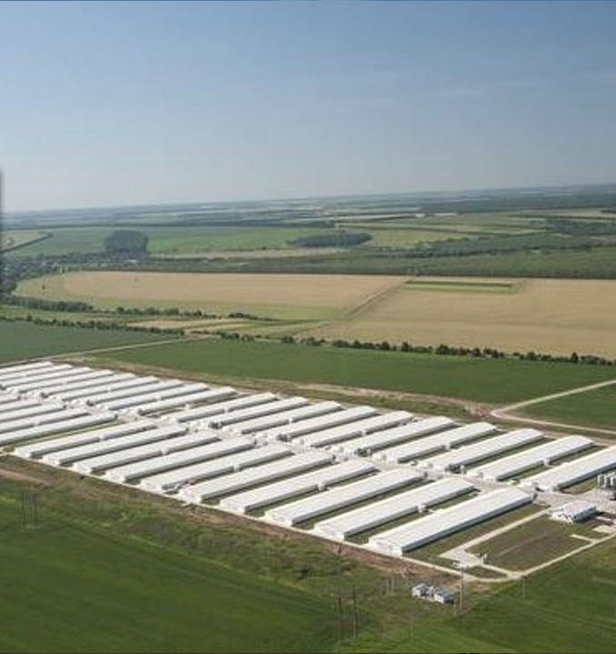
2. Presentation of the impact of the trade liberalization for EU producers and manufacturers
Poultry:
In 2023 EU poultry meat imports reached 230 000 t (cwe)
The existing TRQ before trade liberalization is 90 000 T net weight.
Products imported are almost exclusively breast meat, either fresh or frozen, which is the most valuable of the chicken: each time 2 breasts are imported, a chicken will not be produced in the EU.
Those imports have a significant impact on EU prices of breast meat market, affecting neighboring countries and especially Poland, but then by contagion, all EU countries
Imports are most predominantly coming from 1 single company, with total different farming model: 400 000 ha of land, produce in gigantic units (2 million chickens per farm), registered in Cyprus
EU rules applying on animal welfare (e.g. broiler welfare Directive), environmental aspects (e.g. IED) and antibiotics are not applied in Ukraine
Suspicion of circumvention of the controls at the border making the quantities declared by the COM under evaluated

Slide 9
2. Presentation of the impact of the trade liberalization for EU producers and manufacturers
Eggs:
Find fresh eggs on EU super market shelves (neighboring countries, but also Spain, Austria, Belgium, Netherlands), but they do not fit EU AW standards ( 100% battery cage eggs)
Prices much below EU eggs, losing markets

Slide 10
2. Presentation of the impact of the trade liberalization for EU producers and manufacturers
Sugar:
• Clear incentive to grow more beet and more sugar in Ukraine to be exported to the EU :
- Ukrainian Government and industry expect to export 650,000 tonnes of sugar to the EU – more than 30 times Ukraine’s annual import quota established by the 2014 Association Agreement. According to the Ukrainian Ministry of Agriculture, sugar beet farming expanded by 38 % in 2023/24
Ukraine sugar industry anticipates further growth in sugar beet area and production, potentially resulting in an exportable sugar surplus of around 1 million tonnes in 2024/25
• Leading to disruption of the EU single market and disruption of regional markets has taken place in neighboring countries pushing some Member States to decide unilateral provisions,
• EU prices (average market price, average short-term price and spot values) have started to decrease since summer 2023 (decrease by €250/t of sugar spot values). All analysts consider that the downward trend in prices in the EU is mainly due to these imports from Ukraine.
• EU sugar beet growers’ decision for their sowing 2024/2025 will be impacted downward and as result sugar manufacturers will also be impacted

Slide 11
3. Potential political impact of the trade liberalization without some restrictions
We risk losing support to Ukraine if a good compromise is not found (farmers protests, major topic in some elections)
Loss of the markets in North Africa and Central Asia to the benefit of Russia
When Ukraine will become an EU MS, they should maintain access to previous markets to avoid dependance to the EU
Fragmentation of the EU single market cannot be accepted: we need an EU solution (risk of the licensing system, especially for cereals and oilseeds)

Slide 12
4. Commission’s proposal for the renewal of Ukraine ATM
For Poultry, eggs, and sugar:
Automatic triggering for the period 6th June 2024 to 31st December 2024 (but nothing foreseen for the period 1st January 2024 to 5th June 2024): for poultry, eggs and sugar, if during this period the total amount for the calendar year reaches the volume of the reference period which is the yearly average of years 2022 and 2023, TRQs at the level of the Association Agreement are reinstated until 31st December 2024 (tariffs are implemented for any additional volume and for those with quotats, no possibility to import more). While for the period from 1st January 2025 to 5th June 2025 introduction of TRQs either equal to five twelfths of the yearly average for year 2022-2023 or the Association Agreement TRQs, whichever is higher.
Automatic triggering for the period 1st January 2025 to 5th June 2025: for poultry, eggs and sugar, if during this period the total amount for the calendar year reaches five twelfths of the yearly average for year 2022-2023, the Commission will reinstate TRQs at the level of the Association Agreement.
TRQs should be triggered not later than 21 days after those volumes have been reached and the Committee on Safeguards informed, meaning that 21 days could go on with Ukraine continuing its imports.
Summary
Import limits put to average imports 2022/2023

Slide 13
4. Commission’s proposal for the renewal of Ukraine ATM
For cereals, oilseeds and other commodities:
Cereals and oilseeds are not included in this automatic triggering
2 possibilities for the Commission to take safeguards measures for products other than poultry, eggs and sugar (meaning cereals, oilseeds and all others) for which a Ukrainian product adversely affects the Union market or the market of one or several Member States for like or directly competing products:
On its own initiative OR following a substantiated request from an MS, the Commission has to launch an assessment that should be concluded in 4 months. If the assessment show a real impact on the EU market or on one or several MS market, the Commission can adopt any measure judged necessary by adopting an implementing act through examination procedure
If a delay would cause damage difficult to repair AND if there is a substantiated request from an MS, the Commission may provisionally impose any measure by an implementing act adopted following the advisory procedure to be adopted 21 days maximum after the request has been received
Summary
For other commodities than eggs, poultry, or sugar, no automatic triggering and safeguard measures not defined

Slide 14
4. Commission’s proposal for the renewal of Ukraine ATM
 | Poultry meat | Eggs and albumins | Sugar
Association Agreement TRQs | 70 000t +20 000t (net weight) | 3 000t (expressed in shell eggs equivalent) +3 000t (expressed in net weight) | 20 070t
Volumes for year 2021 | 91 187t (net weight) | 5 590t | 17 495 t
Maximum estimated Ukraine exports for the calendar year 2024 based on Commission’s proposal (1st January to 31st December) | 148 088t (net weight) = 197 018t (carcass weight) | 33 494t | 320 000t (based on previous average monthly imports – this figure will depend on final imports figures between 1 January 2024 and 5 June 2024 which are not limited)
Maximum Ukrainian imports for the first 5 months of 2025 based on Commission’s proposal (1st January to 5th June 2025) | 90 000t (net weight) | 14 000t | 145 000t
Summary
The proposed volumes to trigger the safeguard are too high (x2 poultry, x6 eggs, x16 sugar)

Slide 15
5. Amendments to the proposal required to ensure survival of EU farmers
Use the average year 2021/2022 as the reference period for volumes to provide the right signal to Ukrainian producers and to effectively stabilize these imports
Include cereals and oilseeds in the list of commodities with automatic triggering
TRQs to be put in place 10 days after the tigering volume has been reached for an effective ‘emergency break”
Introduce a system ensuring that the destination for all consignments of Ukrainian agricultural products is determined prior to entry into the EU and introduce a system to guarantee that the Ukrainian products reach this destination and do not end up elsewhere.

Slide 16
5. Amendments to the proposal required to ensure survival of EU farmers
 | Poultry meat | Eggs and albumins | Sugar
Association Agreement TRQs | 70 000t +20 000t (net weight) | 3 000t (expressed in shell eggs equivalent) +3 000t (expressed in net weight) | 20 070t
Volumes for year 2021 | 91 187t (net weight) | 5 590t | 17 495
Maximum estimated Ukraine exports for the calendar year 2024 (1st January to 31st December) | 148 088t (net weight) = 197 018t (cwe) OUR PROPOSAL (average 2021/2022) 127 596 t (cwe) | 33 494t OUR PROPOSAL (average 2021/2022) 14 606t | 320 000t (except if export more until 6th June 2024) OUR PROPOSAL (average 2021/2022) 85 200 t
Maximum Ukrainian imports for the first 5 months of 2025 (1st January to 5th June 2025) | 90 000t (net weight) OUR PROPOSAL (average 2021/2022) 90 000t (net weight) | 14 000t OUR PROPOSAL (average 2021/2022) Maximum 6 085t | 145 000t OUR PROPOSAL (average 2021/2022) Maximum 35 500 t

Slide 17
Thank you

